Slide 1

Comparative Analysis of Air Quality Index using Machine Learning and Large Language Models
SRM INSTITUTE OF SCIENCE AND TECHNOLOGY
FACULTY OF ENGINEERING AND TECHNOLOGY
DEPARTMENT OF COMPUTING TECHNOLOGIES
Subject Code: 18CSP109L
3rd review
G.Sai harish(RA2011003011185)
v.Chandra sekhar (RA2011003011180)
Dr.s.Shanmugam
Assistant professer

Slide 2
ABSTRACT
Air pollution alludes to the issue of toxins into the air that are harmful to human well being and the entire planet. It can be described as one of the most dangerous threats that the humanity ever faced.
It causes damage to animals, crops, forests etc. To prevent this problem in transport sectors have to predict air quality from pollutants using machine learning techniques. Subsequently, air quality assessment and prediction has turned into a significant research zone.

Slide 3
INTRODUCTION
Machine learning is to predict the future from past data. Computer studying (ML) is a style of artificial intelligence (AI) that delivers computers the capability to gain knowledge of without being explicitly programmed. Machine finding out makes a speciality of the progress of pc applications that can alternate when exposed to new information and the basics of laptop studying, implementation of a easy laptop finding out algorithm utilizing python. Process of coaching and prediction involves use of specialised algorithm. It feed the training data to an algorithm, and the algorithm uses this training knowledge to offer predictions on a brand new test information.

Slide 4
MOTIVATION
The inclusion of a hands-on implementation using Python serves as a practical catalyst for engagement. By demonstrating the application of machine learning through a simple algorithm, the project seeks to bridge the gap between theoretical understanding and practical proficiency.
This hands-on approach not only fosters a deeper comprehension of machine learning concepts but also makes the technology more accessible to a broader audience, encouraging active participation and exploration.

Slide 5
Literature survey
S.NO | TOPIC | CONTENT | AUTHOR | YEAR
1. | Low Cost Sensor With IoT LoRaWAN Connectivity and Machine Learning-Based Calibration for Air Pollution Monitoring | . Air pollution poses significant risk to environment and health. Air quality monitoring stations are often confined to a small number of locations due to the high cost of the monitoring equipment. They provide a low fidelity picture of the air quality in the city; local variations are overlooked. However, recent developments in low-cost sensor technology and wireless communication systems like Internet of Things (IoT) provide an opportunity to use arrayed sensor networks to measure air pollution, in real time, at a large number of locations | Sharafat Ali; Tyrel Glass; Baden Parr; Johan Potgieter | 2020

Slide 6
Literature survey
S.NO | TOPIC | CONTENT | AUTHOR | YEAR
2. | Selective Detection of VOCs With WO₃ Nanoplates-Based Single Chemiresistive Sensor Device Using Machine Learning Algorithms | . The paper presents the integration of single metal-oxide based chemiresistive sensor device and machine learning tools for selective discrimination of different volatile organic compounds (VOCs) for indoor air quality monitoring applications. Tungsten oxide (WO ₃ ) nanoplates has been employed as the gas sensing material which were obtained by acidification followed by low temperature hydrothermal process. | Snehanjan Acharyya; Sudip Nag; Prasanta Kumar Guha | 2020

Slide 7
Literature survey
S.NO | TOPIC | CONTENT | AUTHOR | YEAR
3. | Graph Neural Network for Air Quality Prediction: A Case Study in Madrid | Air quality monitoring, modelling and forecasting are considered pressing and challenging topics for citizens and decision-makers, including the government. The tools used to achieve the above goals vary depending on the opportunities provided by technological development. Much attention is currently being paid to machine learning and deep learning methods, which, compared to domain knowledge methods, often perform better in terms of capturing, computing and processing multidimensional information and complex dependencies. | Ditsuhi Iskandaryan, Francisco Ramos, Sergio Trilles | 2023

Slide 8
Literature survey
S.NO | TOPIC | CONTENT | AUTHOR | YEAR
4. | Air Quality Index Forecasting via Genetic Algorithm-Based Improved Extreme Learning Machine | Air quality has always been one of the most important environmental concerns for the general public and society. Using machine learning algorithms for Air Quality Index (AQI) prediction is helpful for the analysis of future air quality trends from a macro perspective. When conventionally using a single machine learning model to predict air quality, it is challenging to achieve a good prediction outcome under various AQI fluctuation trends. In order to effectively address this problem, a genetic algorithm-based improved extreme learning machine prediction method is enhanced. | Chunhao Liu, Guangyuan Pan, Dongming Song, Hao Wei | 2023

Slide 9
Literature survey
S.NO | TOPIC | CONTENT | AUTHOR | YEAR
5. | A Sequence-to-Sequence Air Quality Predictor Based on the n-Step Recurrent Prediction | Increasingly, more people are suffering from the effects of air pollution. This study took Beijing as an example and proposed an attention-based air quality predictor (AAQP) that could better protect people from air pollution. The AAQP is a seq2seq model, and it exploits historical air quality data and weather data to predict future air quality indexes. Although existing research has promoted seq2seq for air quality prediction, there are still two problems | Bo Liu, Shuo Yan, Jianqiang Li, Guangzhi Qu, Yong Li, Jianlei Lang, Rentao Gu | 2019

Slide 10
Literature survey
S.NO | TOPIC | CONTENT | AUTHOR | YEAR
6. | A Predictive Data Feature Exploration-Based Air Quality Prediction Approach | People have been paying more and more attention to air quality because it directly affects people's health and daily life. Effective air quality prediction has become one of the hot research issues. This paper is suffering many challenges, such as the instability of data sources and the variation of pollutant concentration along time series. Aiming at this problem, we propose an improved air quality prediction method based on the LightGBM model to predict the PM2.5 concentration at the 35 air quality monitoring stations in Beijing over the next 24 h. | Ying Zhang, Yanhao Wang, Minghe Gao, Qunfei Ma | 2019

Slide 11
Literature survey
S.NO | TOPIC | CONTENT | AUTHOR | YEAR
7. | Revealing Influence of Meteorological Conditions on Air Quality Prediction Using Explainable Deep Learning | Meteorological conditions have a strong influence on air quality and can play an important role in air quality prediction. However, due to the “black-box” nature of deep learning, it is difficult to obtain trustworthy deep learning models when considering meteorological conditions in air quality prediction. To address the above problem, in this paper, we reveal the influence of meteorological conditions on air quality prediction by utilizing explainable deep learning. | Yuting Yang, Gang Mei, Stefano Izzo | 2022

Slide 12
Literature survey
S.NO | TOPIC | CONTENT | AUTHOR | YEAR
8. | Innovative Spatial-Temporal Network Modeling and Analysis Method of Air Quality | Air quality system is characterized by dynamism, dependency, and complexity. Scientifically representing the internal structure of air mass distribution and its relationship to reveal the dynamic evolution of air quality is the key to solve the air pollution problem. This paper abstracts the air quality system into the complex network innovatively by synthesizing spatial and temporal factors influencing air quality status. Based on quantifying the regional dynamic interconnection and interaction, our modeling approach is proposed to mine the relationship of different regions. | Guyu Zhao, Guoyan Huang, Hongdou He, Qian Wang | 2019

Slide 13
Literature survey
S.NO | TOPIC | CONTENT | AUTHOR | YEAR
9. | Air Quality Prediction Based on Integrated Dual LSTM Model | Air quality prediction is an important reference for meteorological forecast and air controlling, but over fitting often occurs in prediction algorithms based on a single model. Aiming at the complexity of air quality prediction, a prediction method based on integrated dual LSTM (Long Short-Term Memory) model was proposed in this paper. Firstly, the Seq2Seq (Sequence to Sequence) technology is used to establish a single-factor prediction model which can obtain the predicted value of each component in air quality data, independently. | Hongqian Chen, Mengxi Guan, Hui Li | 2021

Slide 14
Literature survey
S.NO | TOPIC | CONTENT | AUTHOR | YEAR
10. | Real Time Localized Air Quality Monitoring and Prediction Through Mobile and Fixed IoT Sensing Network | Air pollution and its harm to human health has become a serious problem in many cities around the world. In recent years, research interests in measuring and predicting the quality of air around people has spiked. Since the Internet of Things (IoT) has been widely used in different domains to improve the quality life for people by connecting multiple sensors in different places, it also makes the air pollution monitoring more easier than before. | Dan Zhang, Simon S. Woo | 2020

Slide 15
EXSITING SYSTEM
Urban air pollutant attention forecast is coping with a surge of large ecological monitoring data and intricate alterations in air pollution. This necessitates effective estimating methods to strengthen prediction accuracy and avoid grave contamination episodes, thereby improving ecological administration resolution-making capacity.
A brand new contaminant concentration estimation process is established on sizeable amounts of ecological knowledge and deep learning approaches. This integrates colossal data using two forms of deep networks.

Slide 16
DISADVANTAGES OF EXISTING SYSTEM
They provide limited accuracy as they are unable to predict the extreme points i.e. the pollution maximum and minimum
Cut-offs cannot be determined using such approach
They use inefficient approach for better output prediction

Slide 17
Objective :
They provide limited accuracy as they are unable to predict the extreme points i.e. the pollution maximum and minimum
Cut-offs cannot be determined using such approach
They use inefficient approach for better output prediction.
The existence of complex mathematical calculations
Equal treatment to the old data and new data

Slide 18
INNOVATION IDEA OF THE PROJECT
The innovative concept here is to introduce LLM models as a novel tool to calculate and prompt engineering solutions tailored to the impacts of climate change.
Unlike traditional climate models, LLM models can offer a more localized and nuanced understanding of environmental changes, presenting a unique opportunity to revolutionize climate-responsive engineering.

Slide 19
SCOPE AND APPLICATION
The project can contribute to comprehensive environmental monitoring, helping regulatory bodies and policymakers make informed decisions.
The project has a direct impact on public health by providing early warnings and insights into air quality-related health risks.
Urban planners can benefit from the project's insights to design and develop sustainable cities with reduced environmental impact.

Slide 20
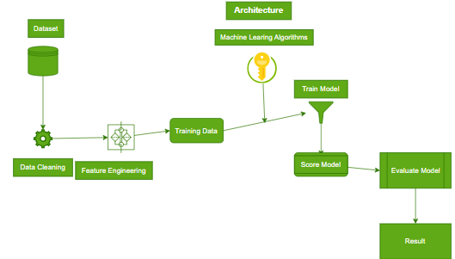
ARCHITECTURE

Slide 21
MODULES
Data cleaning and correlation will be removed.
Data set will be passed to different regression machine learning algorithms and accuracy based parameters will be measured.
The same dataset will be measured using llm model using openai and comparative analysis of the both models.
The output will be evaluated.

Slide 22
Algorithms Used
Linear Regression
Polynomial Regression
Step-Wise Regression
Ridge Regression
LLM Model of gpt-3.5-turbo-instruct

Slide 23
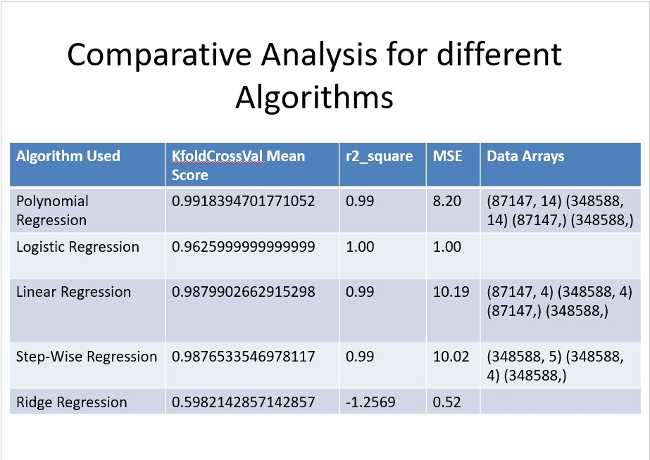
ALGORITHMS

Slide 24

IMPLEMENTATION

Slide 25

IMPLEMENTATION

Slide 26

IMPLEMENTATION

Slide 27
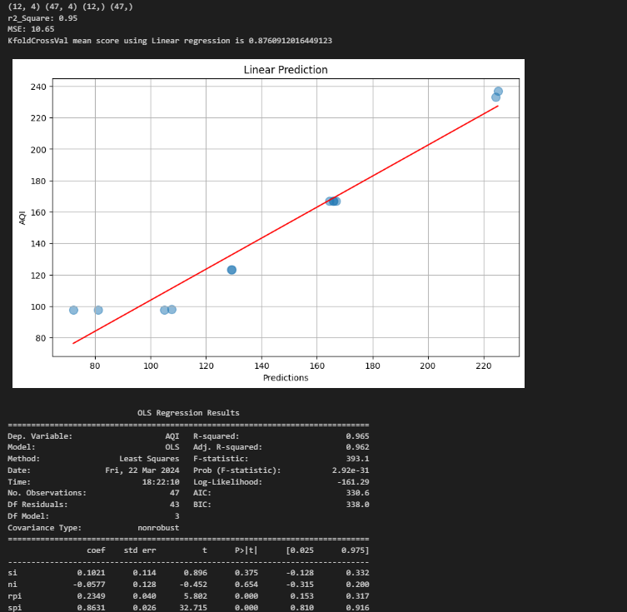
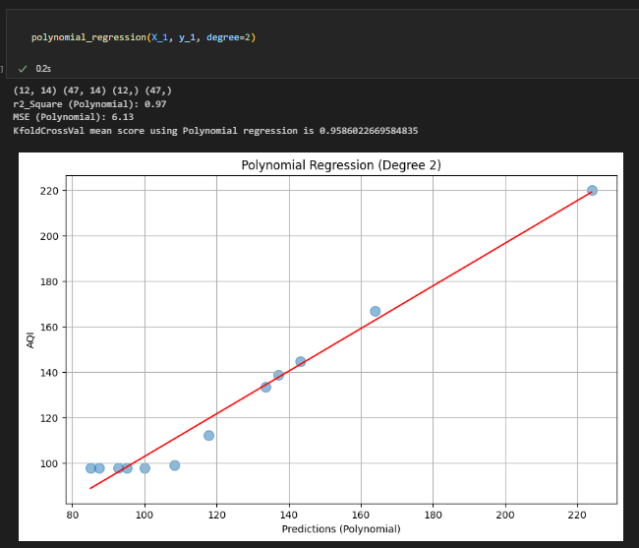
OUTPUTS

Slide 28
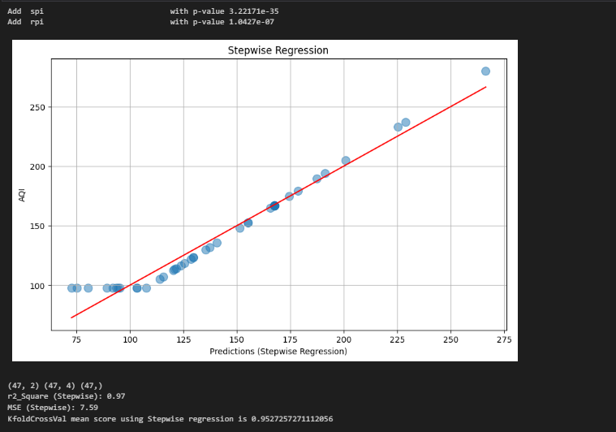
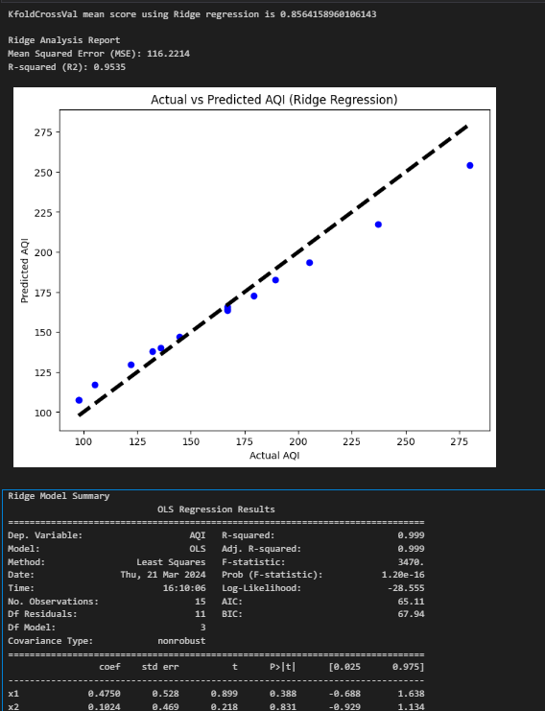

Slide 29


Slide 30


Slide 31
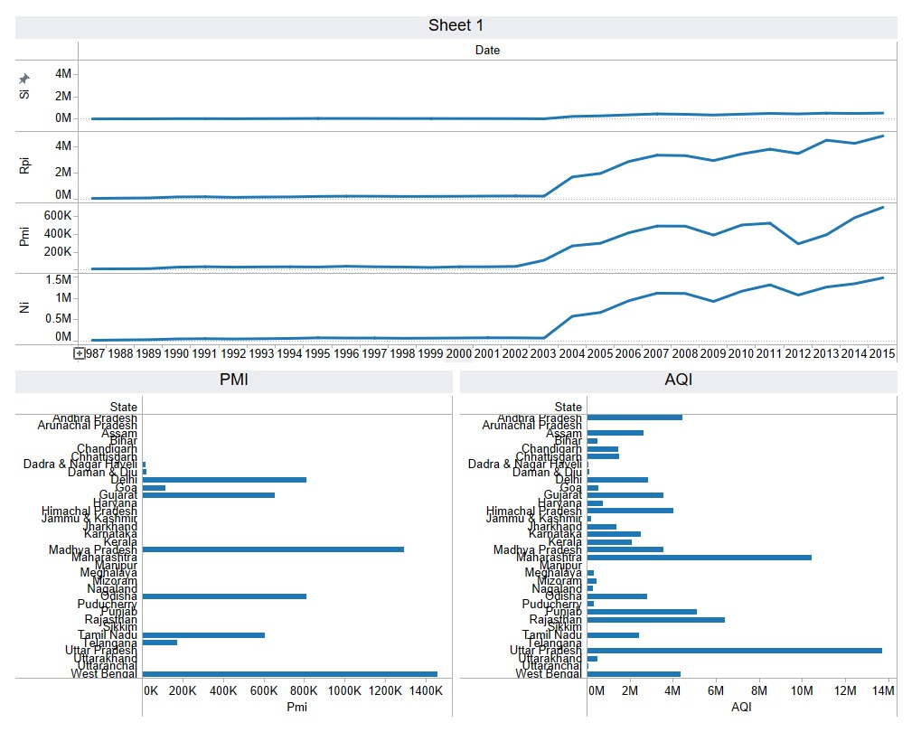
Analysis

Slide 32
Parameters of all Models
Alogirithm used | K foldcrossval mean score | R^2square | MSE | Data arrays
Ridge regression | 0.9345949 | 0.95 | 11.2214 | 60x12
Stepwise regression | 0.952725727 | 0.97 | 7.59 | 60x12
Polynomial regression | 0.958602266 | 0.97 | 6.13 | 60x12
Linear regression | 0.8760912 | 0.95 | 10.65 | 60x12
Gpt-3.4-turbo-instruct | 0.9491285331 | 0.98291789 | 11.593035176 | 60x12

Slide 33
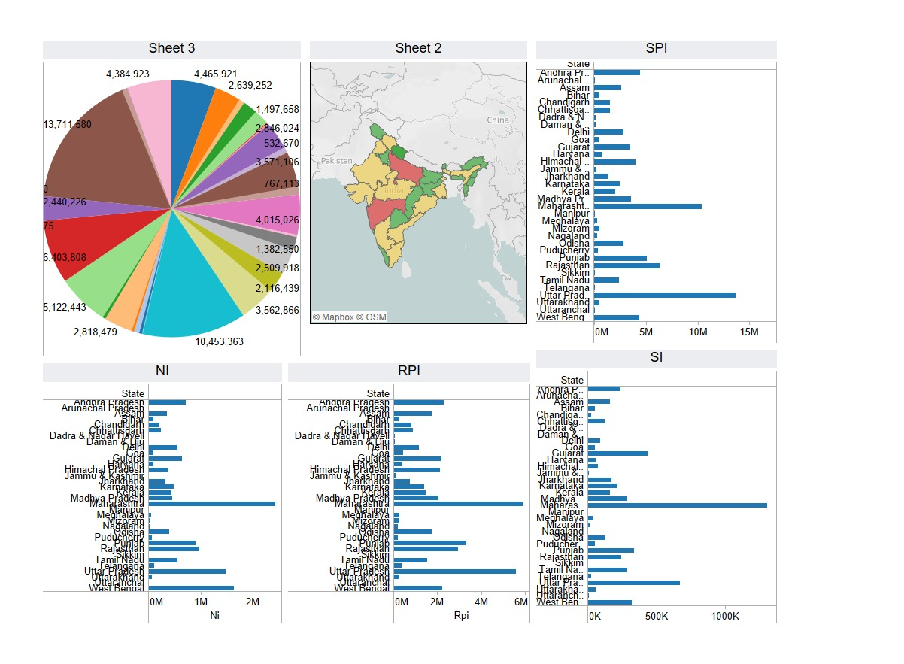
Continution

Slide 34

Result

Slide 35
Reference
[1] (2016). PhishMe Q1 2016 Malware Review. [Online]. Available: https://phishme.com/project/phishme-q1-2016-malware-review/
[2] A. Belabed, E. Aimeur, and A. Chikh, ‘‘A personalized whitelist approach for phishing webpage detection,’’ in Proc. 7th Int. Conf. Availability, Rel. Security (ARES), Aug. 2012, pp. 249–254.
[3] Y. Cao, W. Han, and Y. Le, ‘‘Anti-phishing based on automated individual white-list,’’ in Proc. 4th ACM Workshop Digit. Identity Manage., 2008, pp. 51–60.
[4] T.-C. Chen, S. Dick, and J. Miller, ‘‘Detecting visually similar Web pages: Application to phishing detection,’’ ACM Trans. Internet Technol., vol. 10, no. 2, pp. 1–38, May 2010.
[5] N. Chou, R. Ledesma, Y. Teraguchi, D. Boneh, and J. C. Mitchell, ‘‘Clientside defense against Web-based identity theft,’’ in Proc. 11th Annu. Netw. Distrib. Syst. Security Symp. (NDSS), 2004, pp. 1–16
[6] C. Inc. (Aug. 2016). Couldmark Toolbar. [Online]. Available: http://www.cloudmark.com/desktop/ie-toolbar
[7] J. Corbetta, L. Invernizzi, C. Kruegel, and G. Vigna, ‘‘Eyes of a human, eyes of a program: Leveraging different views of the Web for analysis and detection,’’ in Proceedings of Research in Attacks, Intrusions and Defenses (RAID). Gothenburg, Sweden: Springer, 2014.
[8] X. Deng, G. Huang, and A. Y. Fu, ‘‘An antiphishing strategy based on visual similarity assessment,’’ Internet Comput., vol. 10, no. 2, pp. 58–65, 2006.
[9] Z. Dong, K. Kane, and L. J. Camp, ‘‘Phishing in smooth waters: The state of banking certificates in the US,’’ in Proc. Res. Conf. Commun., Inf. Internet Policy (TPRC), 2014, p. 16.

